Slide 1

FACULTY OF ENGINEERING AND TECHNOLOGY DEPARTMENT
COMPUTER ENGINEERING
CEF440: Internet Programming and Mobile Programming
Task 5
DESIGN AND IMPLEMENTATION
PRESENTED BY: GROUP 9

Slide 2

Agenda
1 | INTRODUCTION
a | OBJECTIVES
b | Diagrammatical Representation
c | Diagram eplanation
2 | UI / UX DESIGNS
a | Introduction and Wireframing
b | Ui elements and color choice
c | Visual design
3 | IMPLEMENTATION
a | Technology Used
b | Developmet Environment
c | Code structure

Slide 3

1. OBJECTIVE
The report is divided into 2 major parts
UI Design
Introduction and Wireframing
UI elements and colour choice
Virtual design
Implementation
Technologies Used
Development Environment
Code Structure

Slide 4

2. UI/UX DESIGN
A. Introduction and Wireframing
Wireframing is a simple visual guide that focus on the layout, structure, and basic functionality of the UI without delving into design details like colours, graphics, or fonts
In this report, we have provided the Low-Fidelity Wireframes.

Slide 5
DIAGRAMATICAL REPRESENTATION OF WIREFRAMING

Slide 6



Benefits of wireframing
Goal # 1
Goal # 2
Goal # 3
Provides clarity and focus
Design testing tool
It Selves as a good design foundation

Slide 7
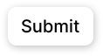

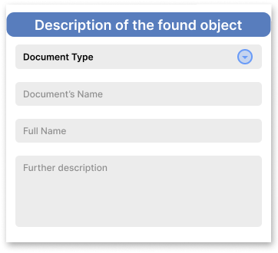
2. UI/UX DESIGN
B. UI elements and color choice
Buttons
Text Fields, Input Boxes and forms:

Slide 8
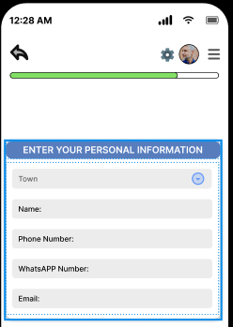



Progression Bar
Icons

Slide 9
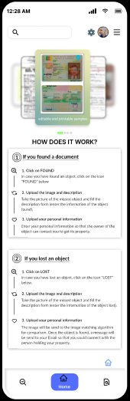
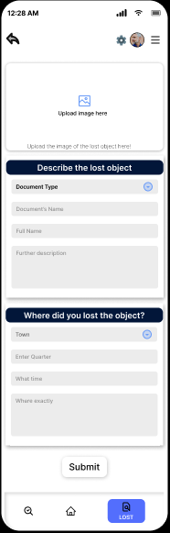
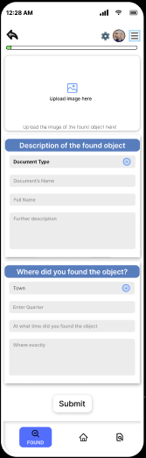
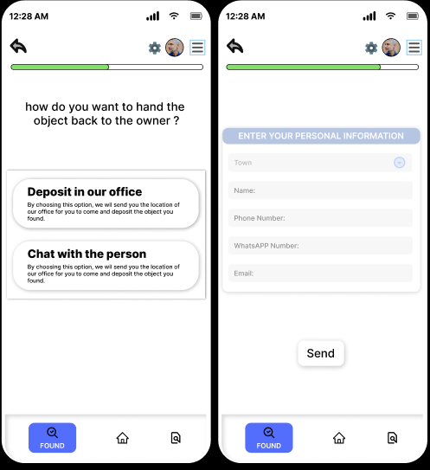
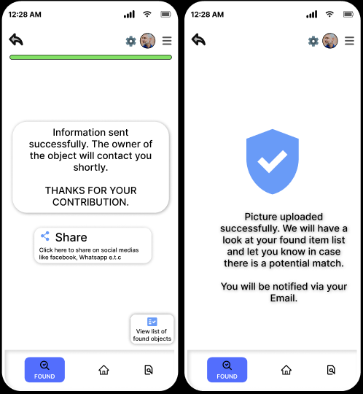
C. Visual Design

Slide 10

3. IMPLEMENTATION
I. Technology Used
Frontend
Programming language: Javascript
Framework : REACT NATIVE
Backend and Database
Programming language: Javascript
Framework : SUPERBASED

Slide 11
II. Development Environment
Tools
FRONTEND TOOLS
Figma
Virtual studio code (VSCODE)
BACKEND TOOLS
Node JS
EXPO

Slide 12
Setup
FRONTEND TOOLS
Figma
Virtual studio code (VSCODE)
BACKEND TOOLS
Node JS
EXPO

Slide 13
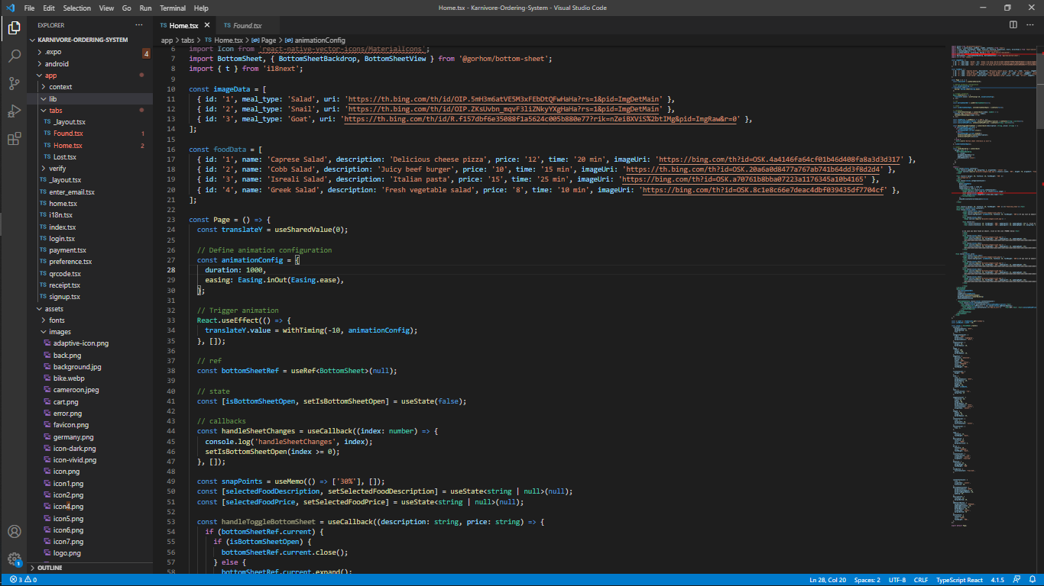
C. Code Structure
D. Summary below

Slide 14
PART | PROGRAMMING LANGUAGE | FRAMEWORK | TOOLS | USE
Frontend | JavaScript | React Native | VS code | Contains all the package for react native and exp. This is where all the codes for the UI elements are written
Backend | JavaScript | Node.js | Node.js Expo go | Nodejs is where all the packages are being downloaded. It is link to the frontend
Database | SQL | Superbase | Superbase Expo | Keeps all the images and associate each image to a finder information
UI DESIGN | _ | _ | FIGMA | It is use to design the UI element and visual design
Resource
Page
Find the magic and fun
in presenting with Canva Presentations. Press the following keys while on
Present mode!
Delete or hide this page
before presenting.

Slide 15
4. CONCLUSION
From image recognition and database management to backend and frontend frameworks, each component plays a crucial role in ensuring the system's efficiency, scalability, and user-friendliness. By leveraging these technologies, the system can effectively manage and retrieve missing objects, providing a valuable solution for various applications.

Slide 16




THANK
YOU
Drag and drop your photo or video! Click the sample photo or video and delete. Select yours from the uploads tab, drag, and then drop inside the frame!

